Slide 1
GitHub Project
Hotel Booking Demand analysis

Slide 2
GitHub Project Details
DataSet : Hotel Booking demand
https://www.kaggle.com/datasets/jessemostipak/hotel-booking-demand/data
Date
January 13 2024
Team Members
Konstantina Drakonaki
Maria Vasileiadou
Eirini Nterou

Slide 3
Dataset Cleaning
Check data
Number of rows
Number of Columns and Types
Nulls
Remove Nulls for country
Drop Duplicates & Reset Index
Correct date types

Slide 4
Data Analysis
Cancellation of Reservation Analysis:
Per Country
Per Market Segment
Per Hotel type
Per leadtime
Price Analysis:
Per Month
Per Hotel type
Reservation Analysis:
Per Month
Per Market Segment
Country
Per Room Type (which type of rooms are most popular)

Slide 5
Cancellation Analysis

Slide 6
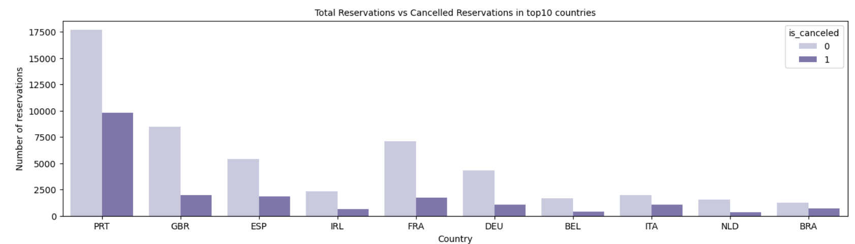
Cancellation Analysis Per Country (Top 10 Countries)

Slide 7
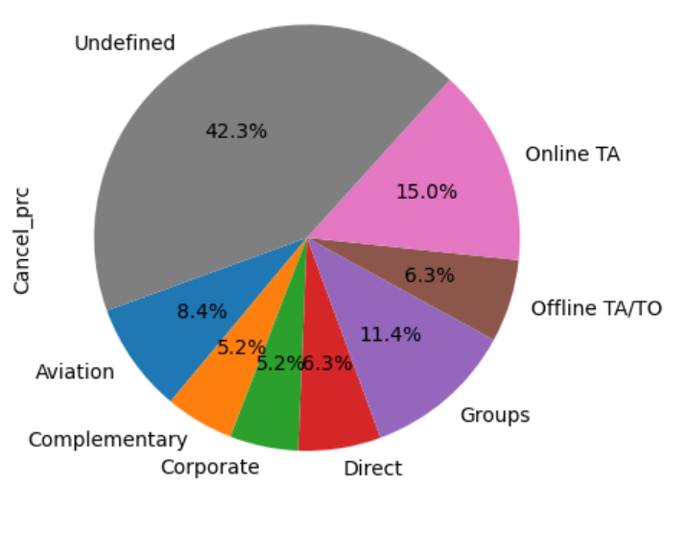
Cancellation Analysis Per Market Segment

Slide 8
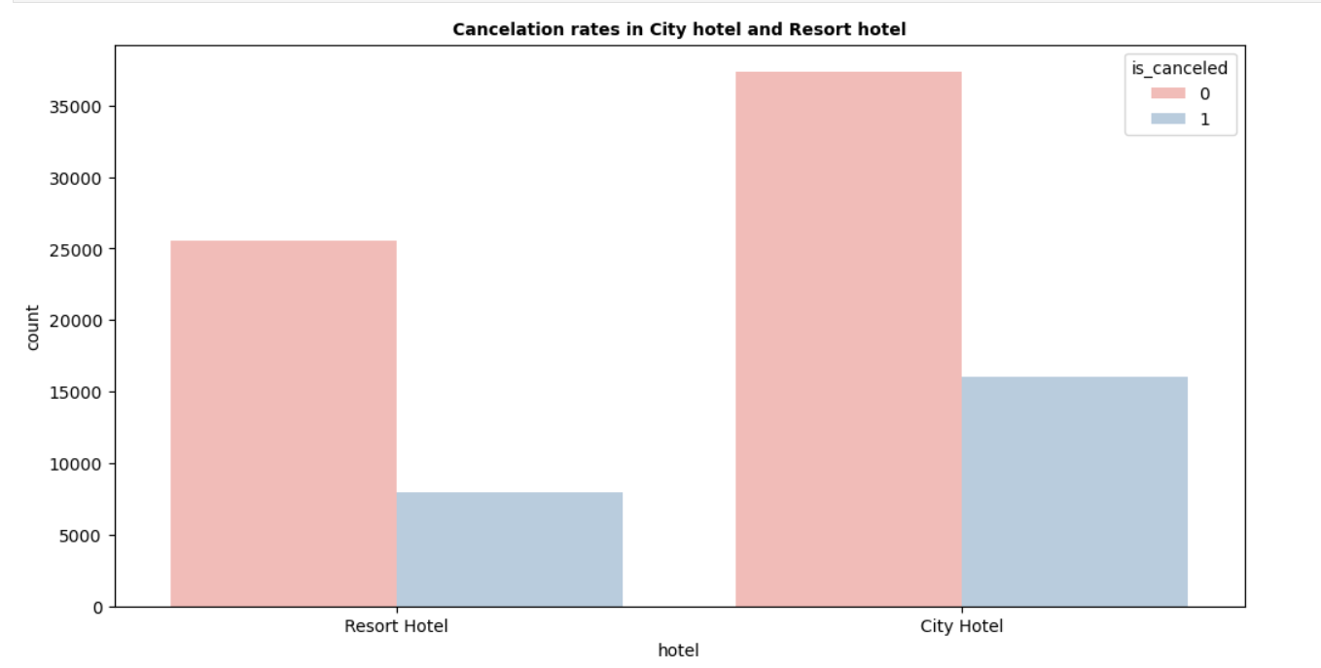
Cancellation Analysis Per Hotel type

Slide 9
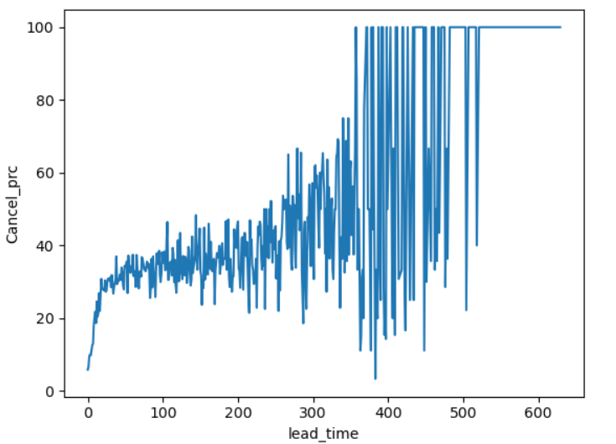
Cancellation Analysis Per Lead Time

Slide 10
Data Analysis Outcomes Cancellation of Reservations
Countries with lower cancellation percentage are GBR, IRL, BEL, IRL
Cancellation percentage is higher for Online TA and Groups
Resort Hotels have lower cancellation rate vs City Hotels
For lead time over 50 days, cancellation chances are higher

Slide 11
Price Analysis

Slide 12
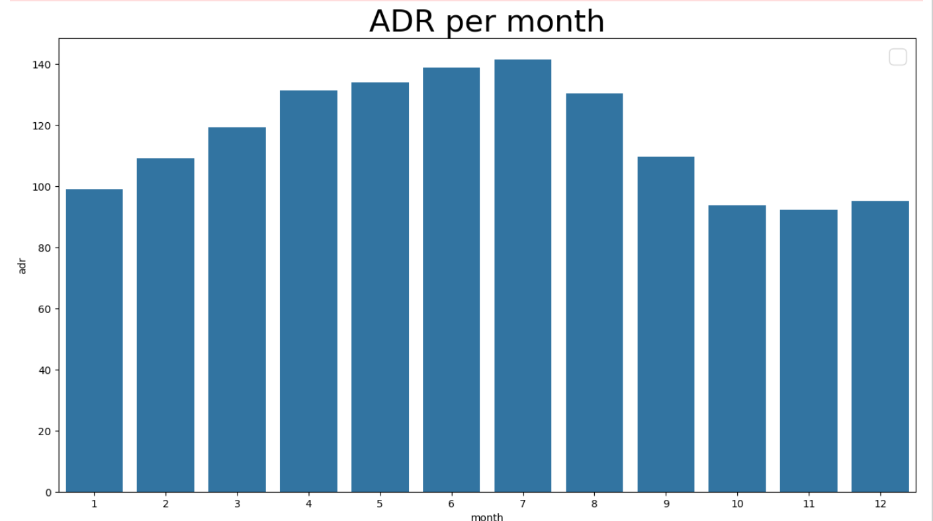
Price Analysis Per Month

Slide 13
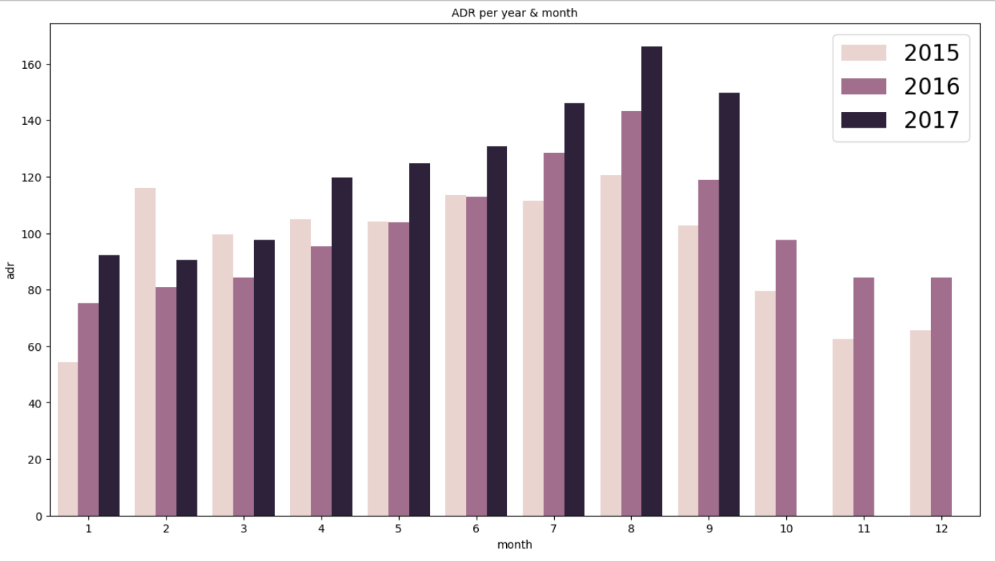
Price Analysis Per Month and Year

Slide 14
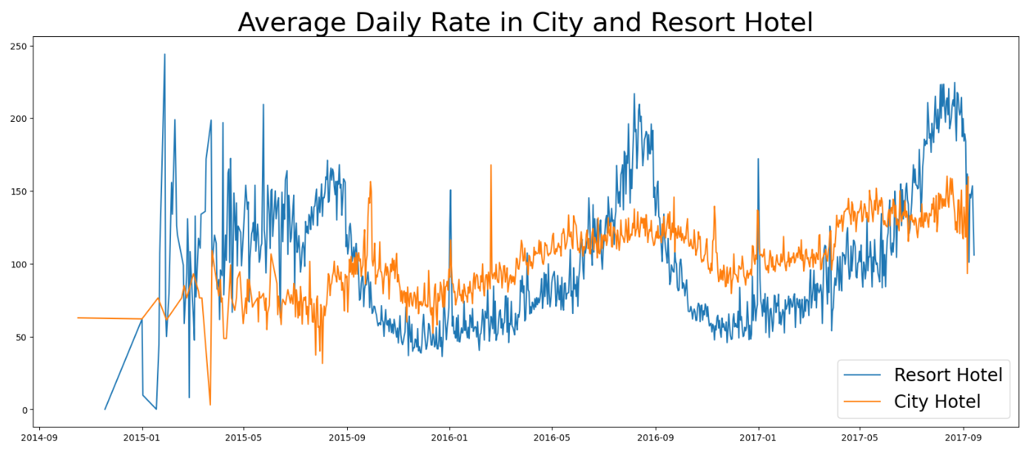
Price Analysis Average Rate Evolution per Hotel Type

Slide 15
Data Analysis Outcomes Price Analysis:
The average daily rate is higher from April – August
For year 2015 this is not absolutely true – prices where high from February - August
The average rate evolution is smoother for city hotels
Increases in average rate are identified on September 2016 & 2017

Slide 16
Reservation Analysis

Slide 17
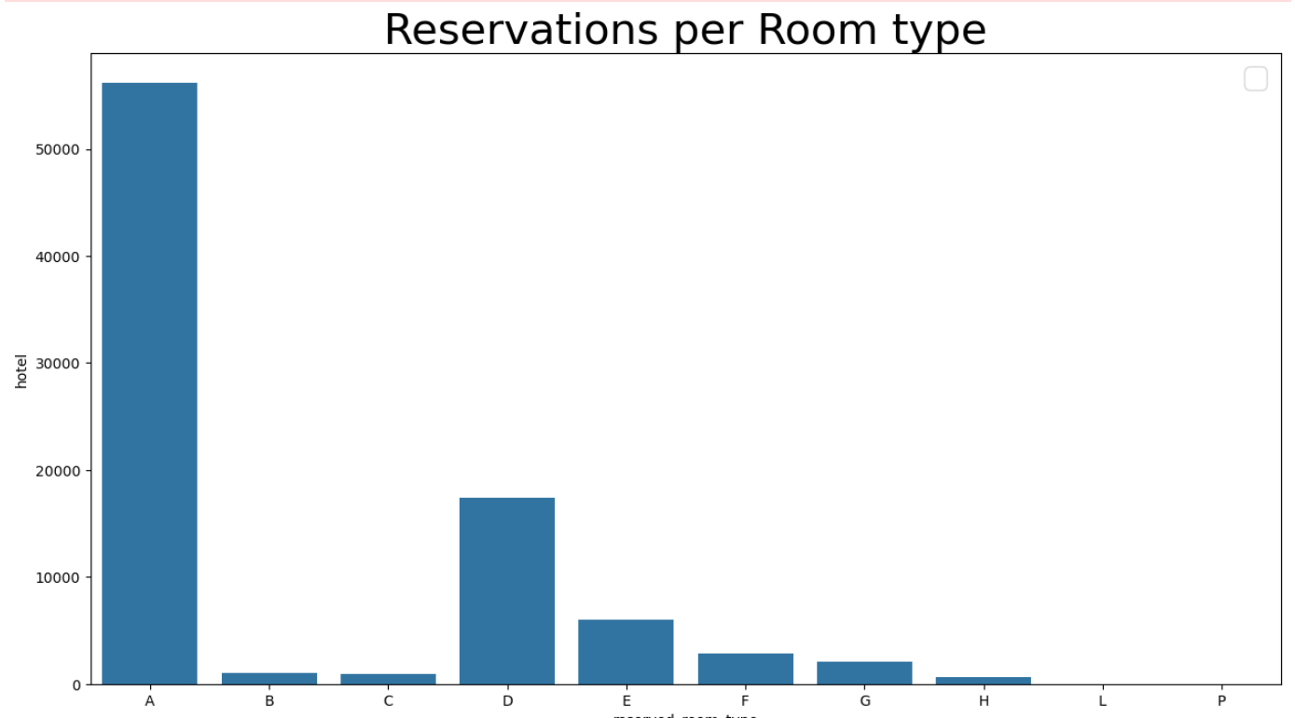
Reservation Analysis Per Room Type

Slide 18
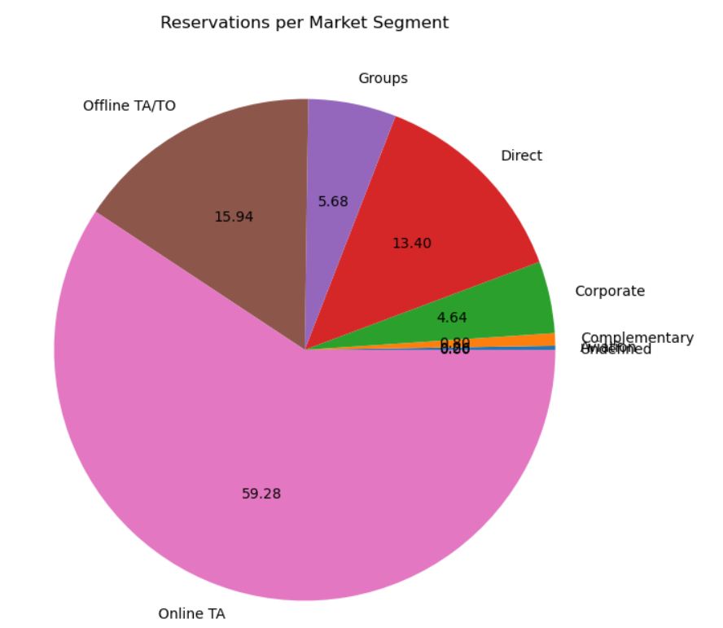
Reservation Analysis Per Market Segment

Slide 19
Data Analysis Outcomes Reservation Analysis:
Most reservations take place from Tas Online
Room types A and D are more popular

